Slide 1
ML Network Intrusion Detection System (NIDS)
Nnamdi Adi

Slide 2
AGENDA
What is a NIDS?
Machine Learning
Model Training
Algorithm Tuning
Demo

Slide 3
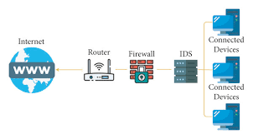
What is a nids?
  Monitors network traffic for malicious activity and flags suspicious activity
  Analyzes flow attributes of packets (duration, byte size, etc)
  Two types of systems
    Signature-based: knows the structure of attacks
    Anomaly-based: knows the structure of normal traffic

Slide 4
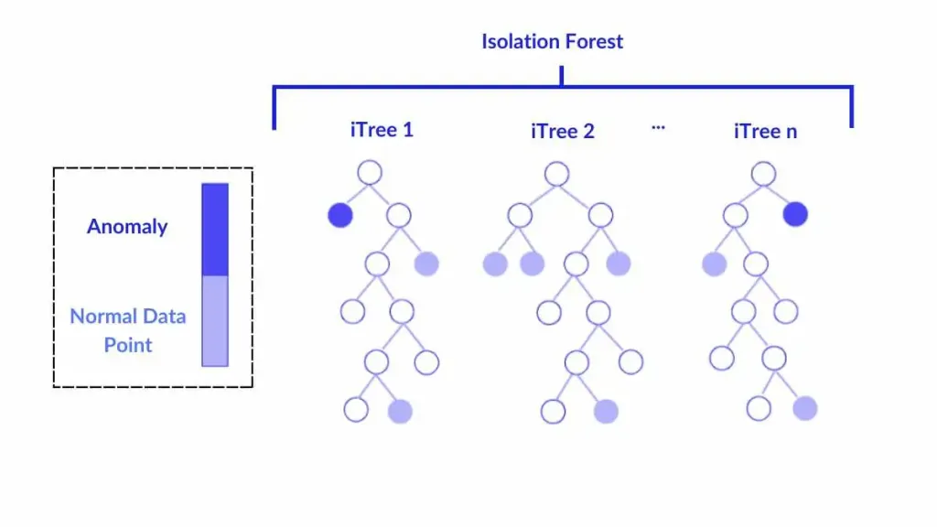
ML application to nids
  Trained multiple ML models to determine flow feature patterns of benign and malicious traffic
    XGBoost-Supervised model using gradient boosting of decision trees (signature-based NIDS)
    Isolation Forest-Unsupervised model using trees to determine feature patterns and isolate paths (anomaly-based NIDS)
  .PCAP files are captured via Scapy and analyzed

Slide 5
Model training
  Trained models on dataset provided by the Canadian Institute of Cybersecurity
  Outlined over 80 flows, but focused on the following 9:
    Flow duration, Total forward/backward packets, total length of forward/backward packets, mean length of forward/backward packets, flow size, flow packets
  Supervised model trained on 4/5 days with 5/7 traffic types
  Unsupervised model trained on one day of purely benign traffic
  Models serialized in a pickle file

Slide 6
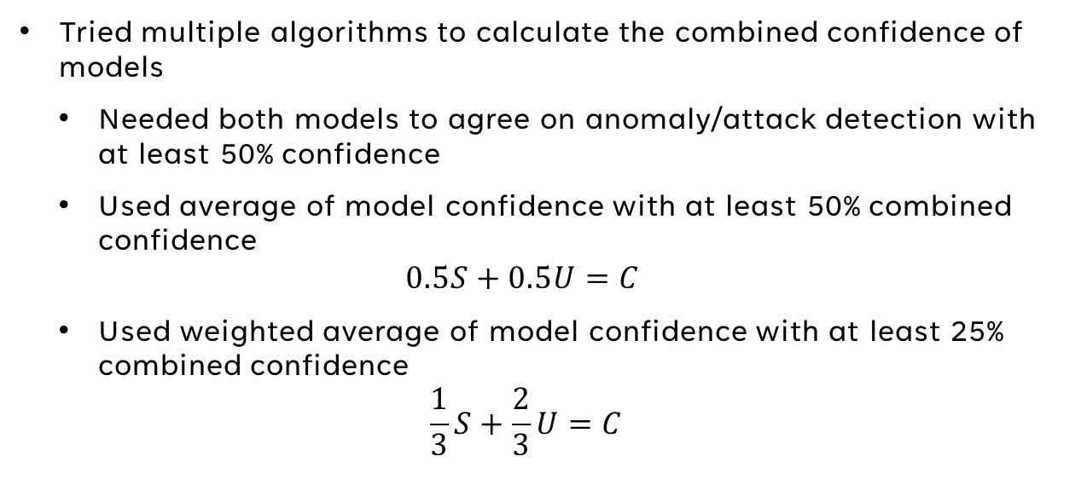
Hybrid arbitration algorithm
Tried multiple algorithms to calculate the combined confidence of models
  Needed both models to agree on anomaly/attack detection with at least 50% confidence
  Used average of model confidence with at least 50% combined confidence
  $$0.5S+0.5U=C$$
  Used weighted average of model confidence with at least 25% combined confidence
  $$\frac{1}{3}S+\frac{2}{3}U=C$$

Slide 7
Demo
Supervised model has seen 5/7 attacks, blind on 2 attacks
Unsupervised model has seen only benign traffic

Slide 8
Questions?

